Slide 1
PG-DAC Project OkStaff (Employee Attendance and Payroll Management System)
Prepared by:
Pranjali Adgokar (200243020055)
Shreya Deshmukh (200243020075)
Shrutika Jadhav (200243020078)

Slide 2
Contents
1. Abstract
2. Introduction to OkStaff Application
3. Technology used in this Project
3. Main Components in OkStaff Application.
4. Flow of the System.
5. Conclusion.

Slide 3
Abstract
Many companies need employee attendance and payroll management. With many people working from home, remote employee management has become important. OkStaff is a web based application for managing employee attendance and payroll. This application is specifically designed to have a contact-less attendance marking system. It calculates salary and generates pay-slips.

Slide 4
Technology Used
Java, Spring Boot REST API, JPA, Angular, Bootstrap, MySQL

Slide 5
Main components in Okstaff Application
ADMIN
EMPLOYEE
MANAGER
MARK ATTENDANCE
MARK
ATTENDANCE
MARK
ATTENDANCE
VIEW AND UPDATE SALARY
VIEW SALARY
LEAVE APPROVE
SEARCH ALL EMPLOYEE
APPLY LEAVE
SEARCH EMPLOYEE
UPDATE /REMOVE EMPLOYEE PROFILE
UPDATE PROFILE
UPDATE PROFILE
PAYSLIP
VIEW PAYSLIP
GENERATE PAYSLIPS
NEW REGISTRATION VIEW

Slide 6
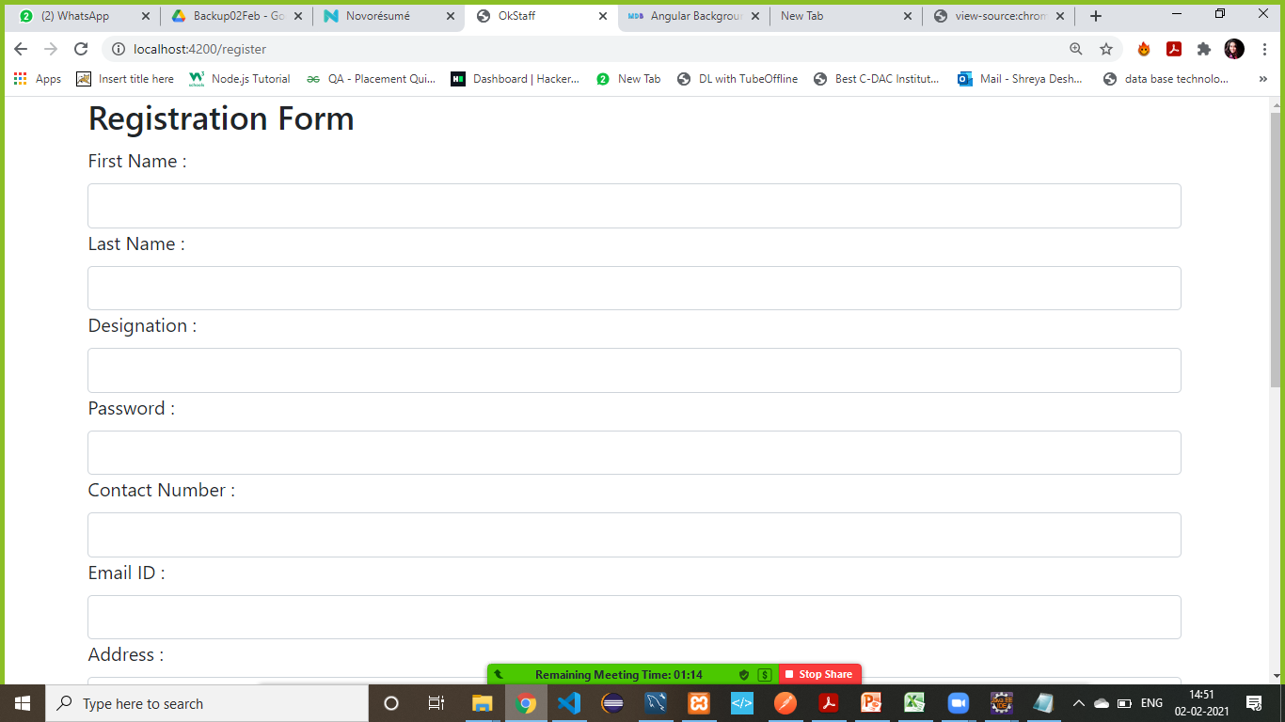
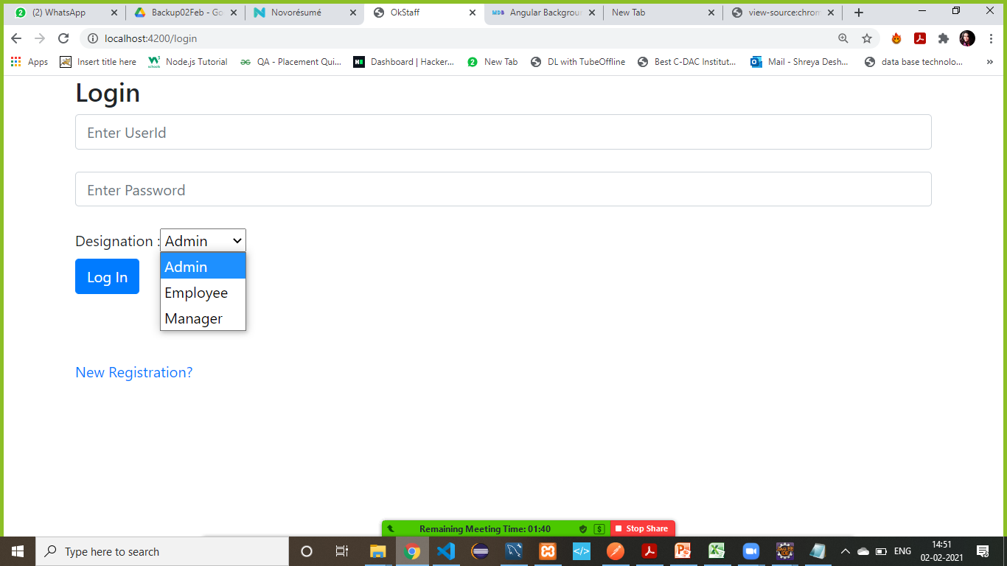
Employee Registration and Login
DB
Login & Logout process is applicable to all Employees

Slide 7
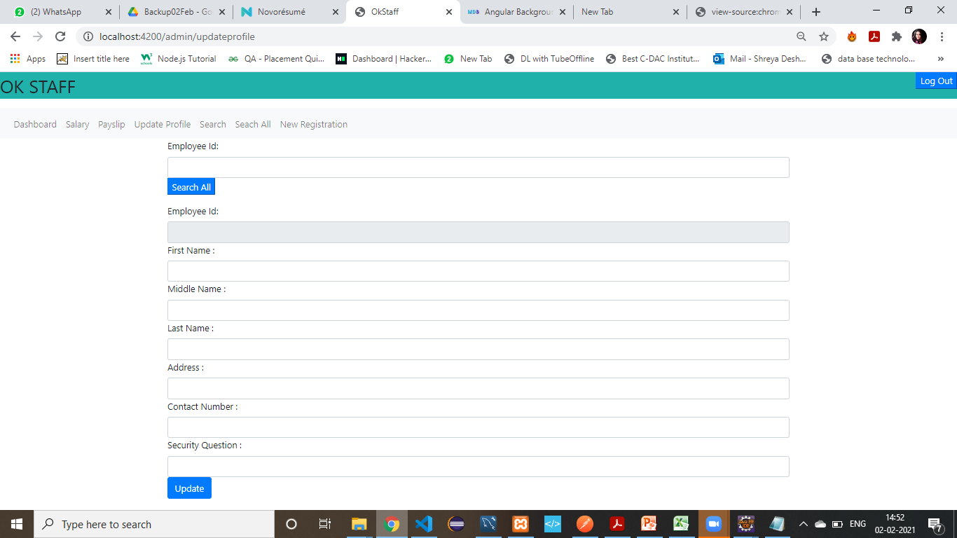
Profile Data Manipulation
Employee can Update his profile .

Slide 8
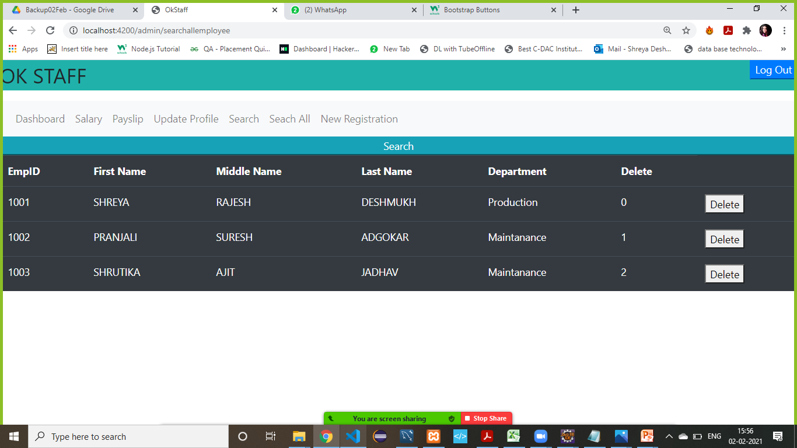
Profile Data Manipulation
Only Admins is able to search all the employees can Update and Remove the profile

Slide 9
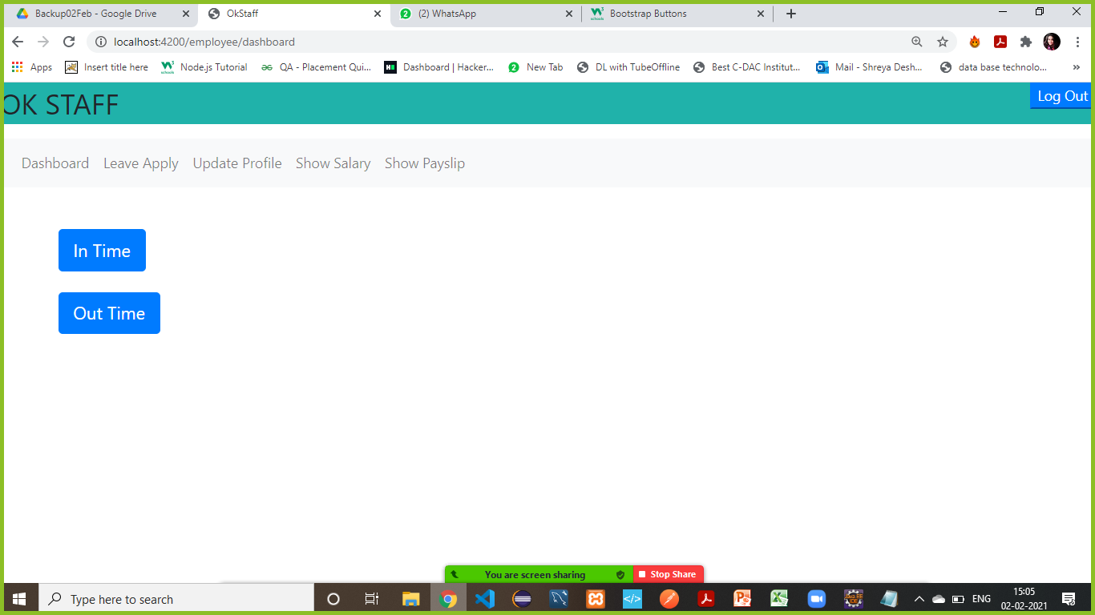
Attendance Marking Process
To mark in time click on In Time button
To mark out time click on Out Time button

Slide 10
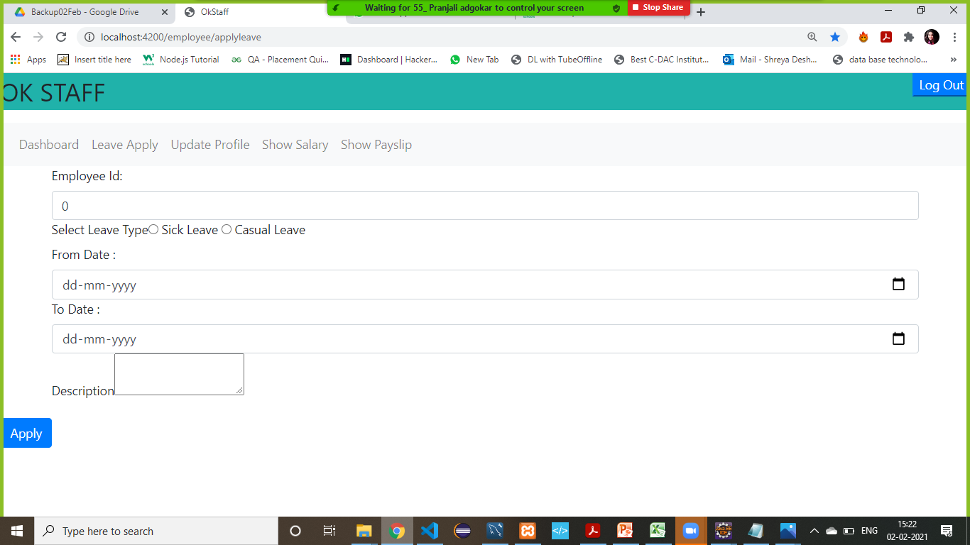
Leave Process
To apply for leave submit the leave application form and click on apply

Slide 11
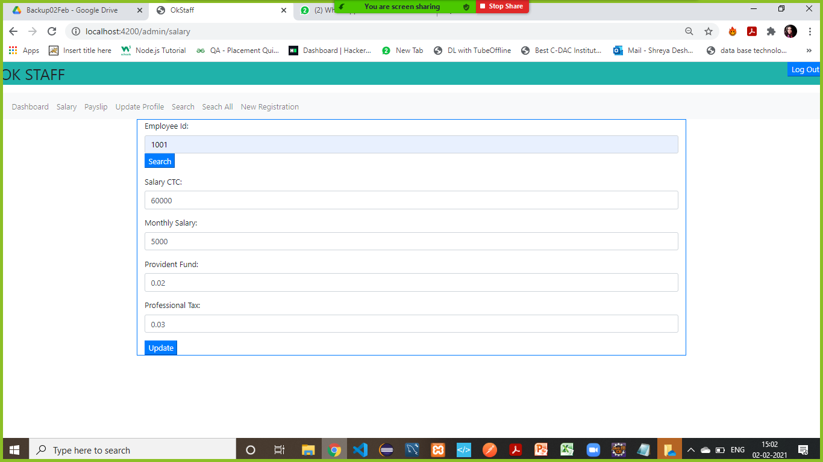
Salary View and Update
Admin can search and Update the Salary Structure

Slide 12
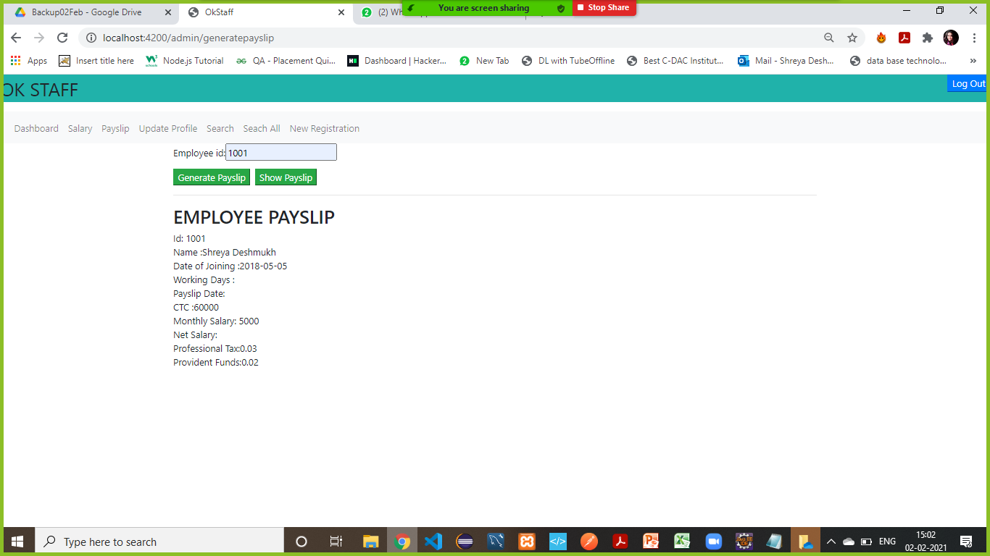
Payslip Generating Process
From here , admin can show the Payslip of the employee with that EmpId.
From here , admin can Generate Payslip of the employee with that EmpId.
This authority is only given to employee

Slide 13
CONCLUSION
It is specifically designed to replace an existing manual record system thereby reducing time taken for calculations and for storing data.

